Slide 1
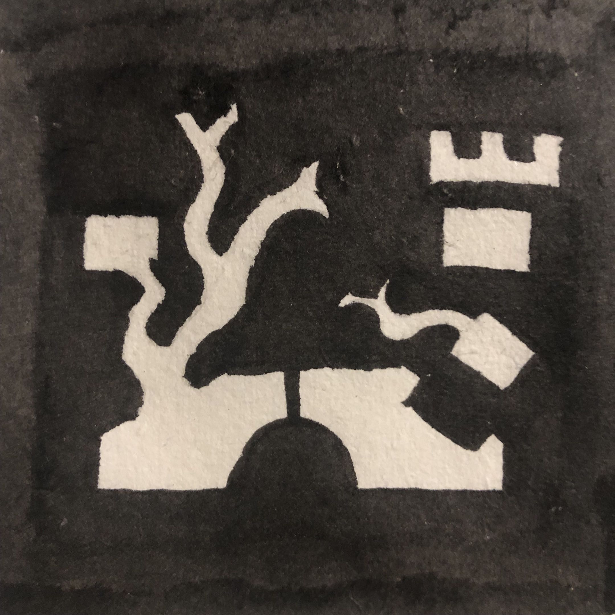
Art Through
Bridged-Imagination

Slide 2
Brimagine is a two-player storytelling game,
that allows players to create their own
characters and abilities.
Characters and abilities must be unique to each player.
Meaning that in a world where billions of
people played this game, even the most
boring ideas would be valuable.

Slide 3
Let’s take some boring ideas
and see how we can make them interesting
Three boring ideas:
– the floor
– a drinking fountain
– homework

Slide 4
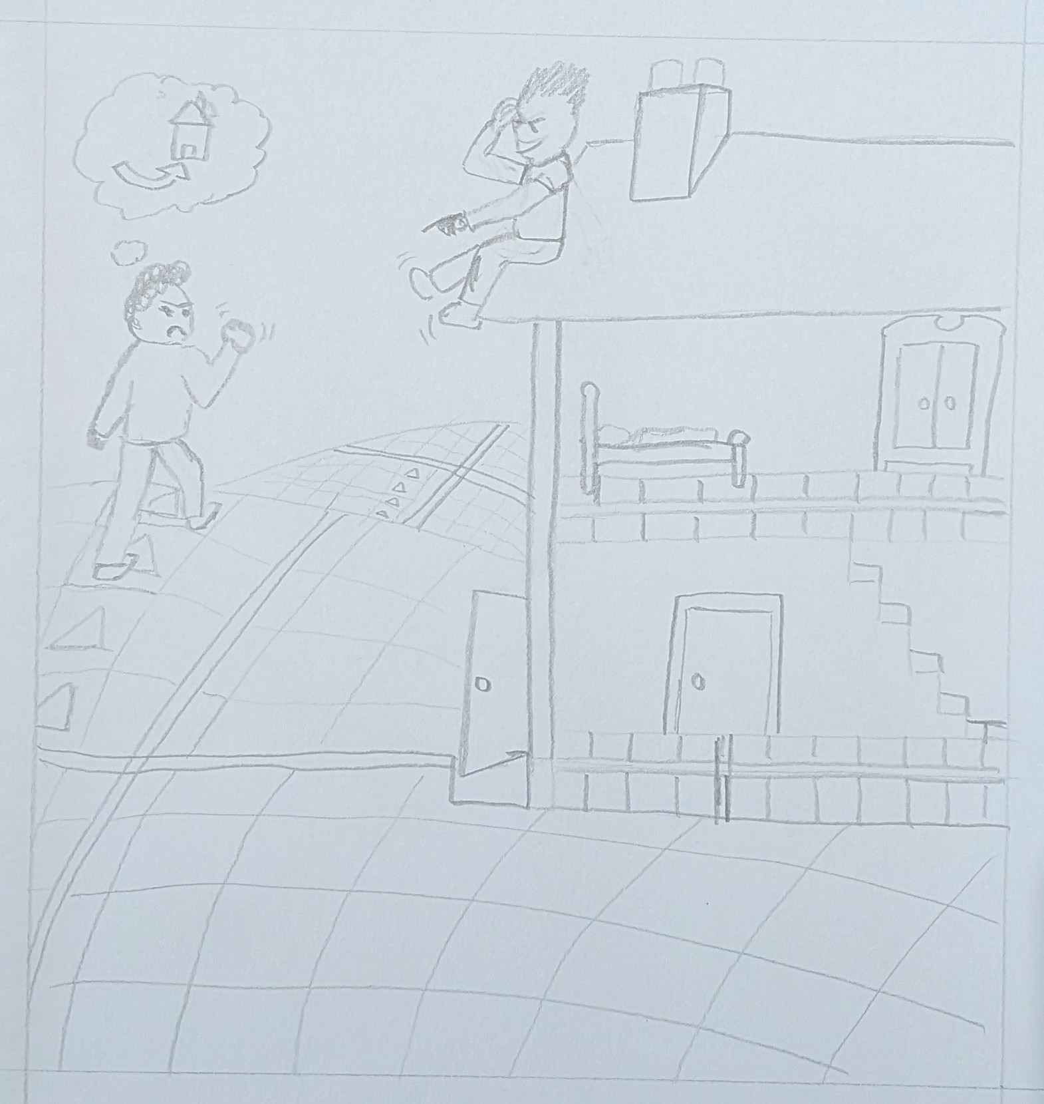
The Floor:
no way it can be interesting?
Bet you forgot about chess.
Because in chess the floor
determines how you move.
So you could have an ability
that patterns all the ground in the world. Then characters can only move certain ways each turn.

Slide 5
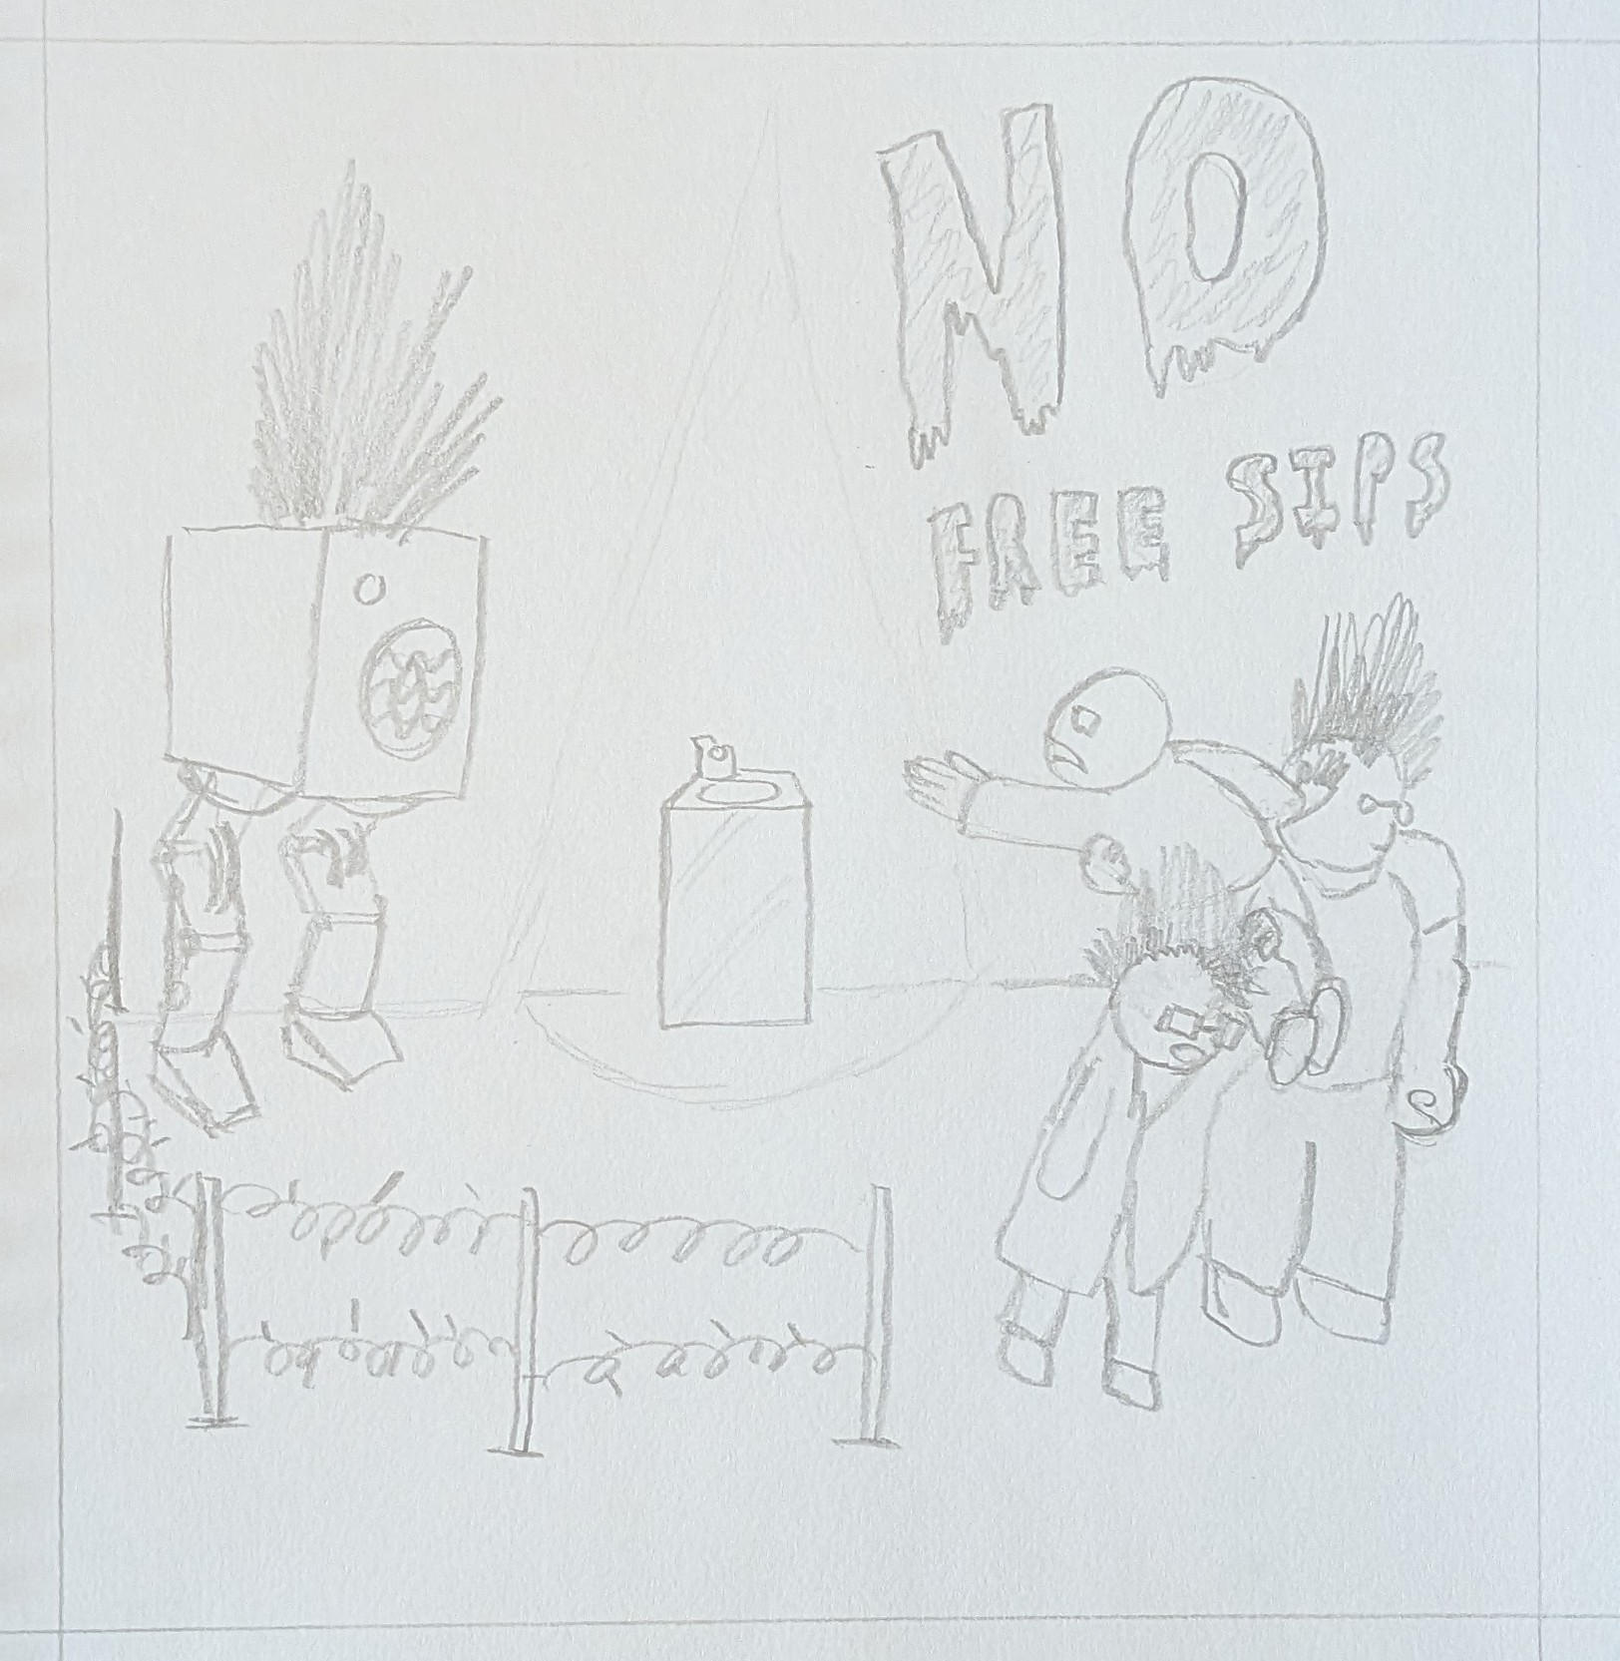
Drinking Fountains:
no way they can be interesting?
What if it’s the apocalypse?
And the only clean water now
Comes from drinking fountains?
Now you have made your opponent’s entire world about trying to budge past apocalypse gangs to get to a drinking fountain.

Slide 6
Homework:
no way that can be interesting?
Yup
That’s your teacher’s problem :P

Slide 7
The point is, now that anything can be interesting
there is way more stuff to make art out of!
Your teacher has been provided with sheets containing lists of ideas for Brimagine characters.
Each of you has a coloured pen (not to be used). Your colour of pen matches a colour next to a box on the sheet. It is your job to sketch a scene inspired by the idea in your box.
Your teacher has few spare characters if you want to swap.

Slide 8
Examples (final slide)

